Slide 1

SPEECH TO TEXT CONVERSION
B.Tech2020.R.CCE.1.19CCE281 - SIGNAL PROCESSING
SEMESTER 3, COMPUTER AND COMMUNICATION ENGINEERING [CCE]
Group 2 Team 6 :
NATESH KUMAAR V - [CB.EN.U4CCE20038]
PRASATH V S - [CB.EN.U4CCE20044]
PRIYANGA R - [CB.EN.U4CCE20045]
R RANGASHREE DHANVANTH - [CB.EN.U4CCE20048]
RIYA KALLANKATTIL PRAMODH KUMAR - [CB.EN.U4CCE20049]

Slide 2
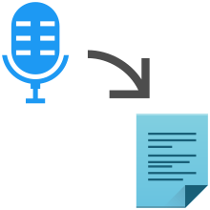
OBJECTIVES
A code to convert audio signals to digital signals by using the principles of Signal processing.
For performing the conversion, we do the technique of sampling of signal
This is obtained by an algorithm called the Fast Fourier Transfer (FFT)
Speech to Text conversion used in Google, Alexa, Siri to name a few
applications uses a combination of deep learning and natural
Language processing (NLP).

Slide 3
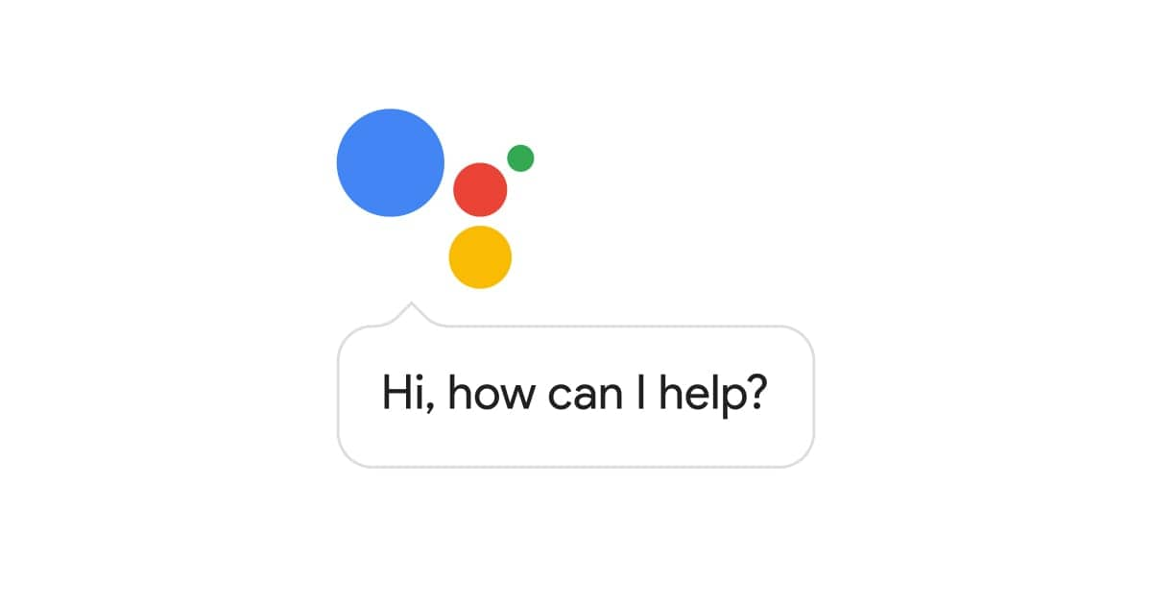
SYSTEM DESCRIPTION AND APPLICATION
Speech to text is the technique by which a device automatically recognizes the audio or
words of an individual on the basis of the information in the speech wave and then converts it into a text output.
The Libraries Used are:
Numpy
Matplotlib.pyplot
Scipy.io.wavfile
Librosa
Speech_recognition
“Hey, there” we get a text output hey there. It has major applications in a lot of modern-day devices like apple Siri, amazon’s Alexa, Windows Speech Recognition, and even normal voice-to-text conversion used in search engines like Google.

Slide 4
METHODOLOGY
Input will be the audio signal and the output will be the text form of that audio signal.
RAW SIGNAL EXTRACTION
1.The input audio file is stored in the .wav form in the same drive of the code
2. The audio file is extracted and the raw audio signals are obtained.
3. The raw audio signals should be first converted from analog to digital
signal which can be done by the A/D converter (analog to digital converter).
4. Pre - emphasis which is done by the first order high pass filter which
increases the magnitude of the energy at higher frequencies.
CONVERTING TIME DOMAIN TO FREQUENCY DOMAIN:
5.Then the signal should be converted from the time domain to the frequency
domain by applying FFT (Fast Fourier Transform).

Slide 5
MFCC TECHINIQUE:
6.Mel-filter bank which can give us high resolution at a lower frequency and
low resolution at a higher frequency.
7.Under the operation of IDFT, we get to know that the fundamental frequency in the
frequency domain is considered as the lowest frequency, whereas in the time domain it
is considered as the highest frequency.
8. MFCC technique performs first order and second order derivative of
the features which again consist of twenty-six other features.
9.MFCC technique produces thirty-nine features from the audio signal samples,
which serves as the input for the given speech to text conversion problem.
SPEECH TO TEXT CONVERSION:
10.Google API is used for the final Speech to text conversion

Slide 6
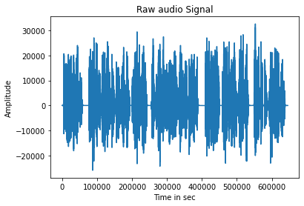
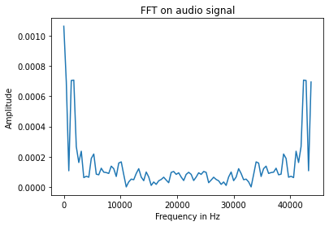
SIMULATION RESULTS:
The audio signal is transformed to frequency domain by performing Fast Fourier transform (FFT).
Frequency vs Power graph of the audio signal
The Audio file(.wav) is read and the signal is plotted in time domain.
Time vs Amplitude Audio signal

Slide 7
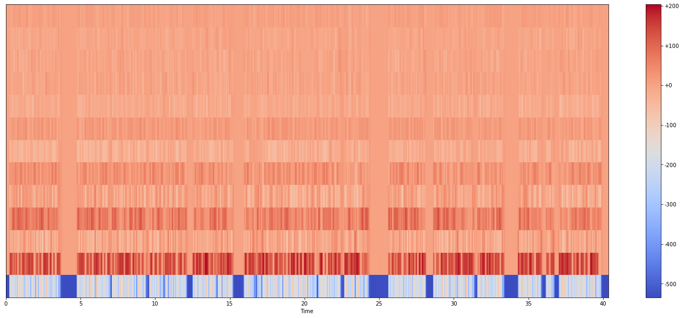
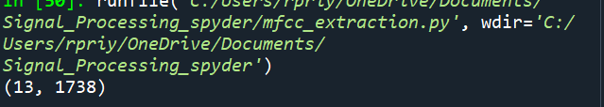
MFCC is performed on the .wav file:
The O/P of Mfccs. shape:

Slide 8
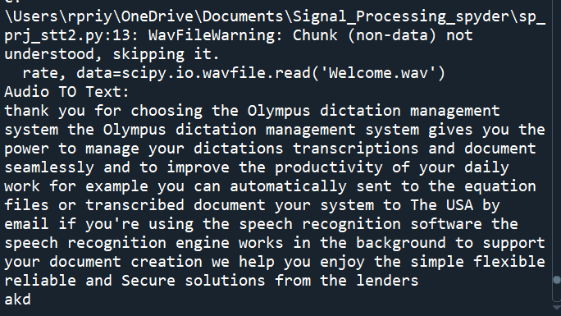
The Final Speech to text conversion of Welcome.wav :

Slide 9
CONCLUSION
By using various principles of signal processing, we have converted the audio signal to a text format.
We get the information on frequency domain by performing Fast Fourier Transform.
MFCC's are obtained using the library librosa And the Google API converts it to the text format
Presently there are large number of Software doing speech to Text conversion:
Google Docs voice Typing
Speech Dictation
Window's Speech recognition

Slide 10
Thank you
REFERENCES
https://www.analyticsvidhya.com/blog/2019/07/learn-build-first-speech-to-text-model-python/
https://www.analyticsvidhya.com/blog/2021/06/mfcc-technique-for-speech-recognition/
https://www.leftrightmind.com/blogs/the-future-of-voice-recognition
https://www.cs.rochester.edu/u/james/CSC248/Lec13
https://www.ijert.org/zigbee-based-wireless-voice-to-text-translator

